Slide 1
Compositional Human Pose Regression
Xiao Sun
Joint work with Yichen Wei

Slide 2
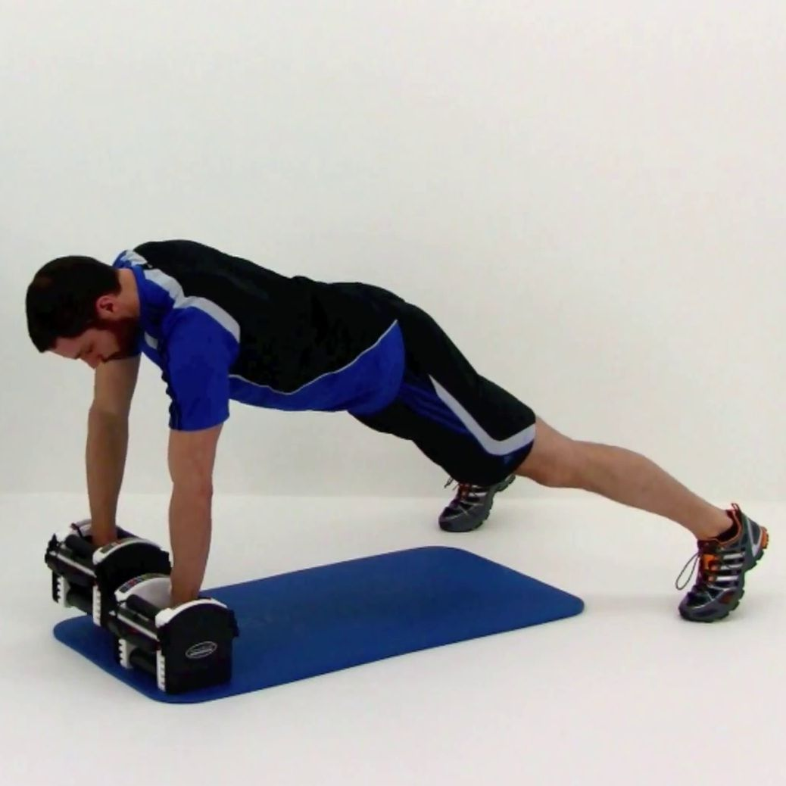
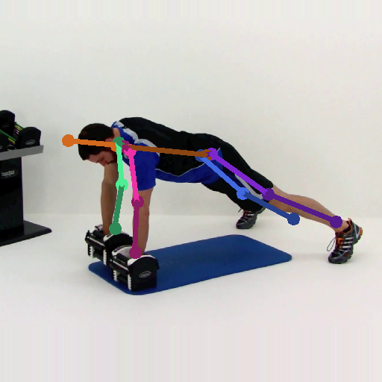
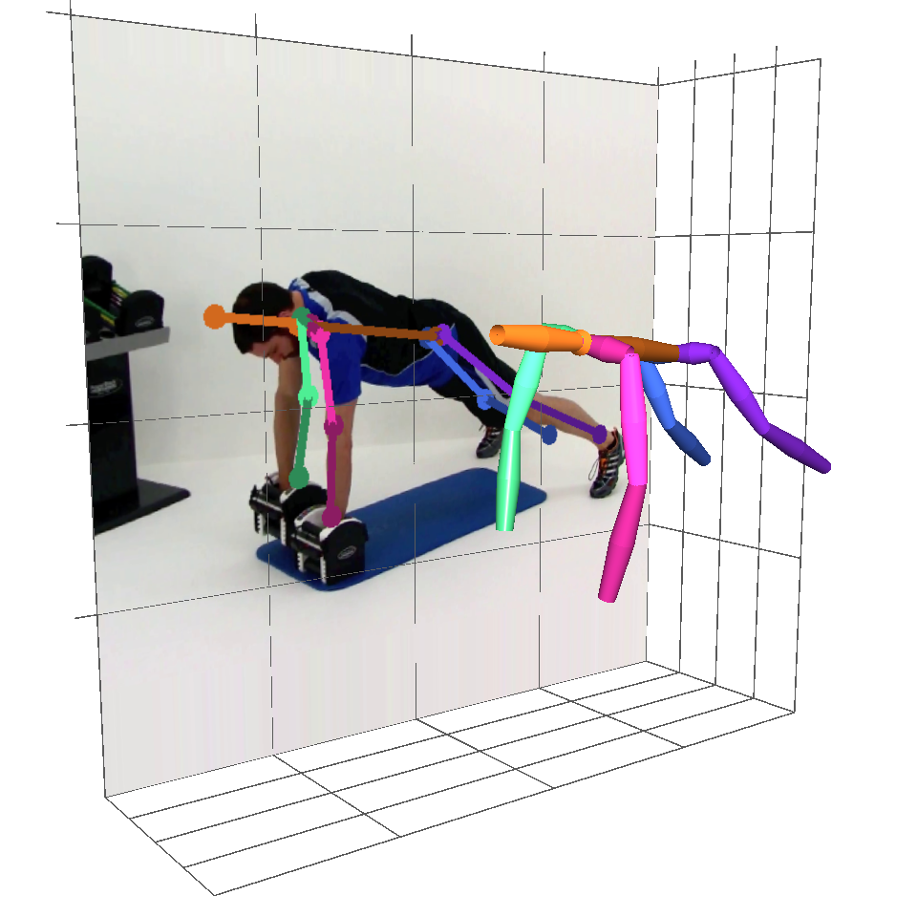
Human Pose Estimation
Problem: localize key points of a person
Input: a single RGB image
Output: 2D or 3D key points
RGB Image (person centered)
Pose Estimator
2D Key Points
3D Key Points
Notes:
The problem of human pose estimation is to localize the key points of a person.
The input is a single RGB image with a person in the image center.
Then a pose estimator is designed to output the location 2D or 3D key points of this person.

Slide 3
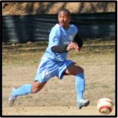
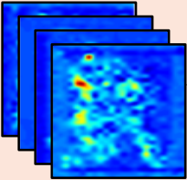
Detection VS. Regression
Detection
Regression
Per-pixel classification
Output: likelihood score maps
Location regression
Output: key points location
Notes:
There are two primary solutions for this problem in the literature. Detection based and regression based. Detection methods classify each pixel into key point classes and output the likelihood score maps, a maximum post-process is usually performed on these score maps to localize the key points. And regression methods directly regress the location of those key points.

Slide 4
Performance
Detection
Regression
Per-pixel classification
Output: likelihood score maps
Used in most 2D methods
State-of-the-art result
Location regression
Output: key points location
Only used in a few 2D methods
Unsatisfactory result
Notes:
However, the performance based on these two methods are quite different. Most of the state-of-the-art 2D human pose estimation methods are detection based, while only a few are regression based and the result is unsatisfactory.

Slide 5
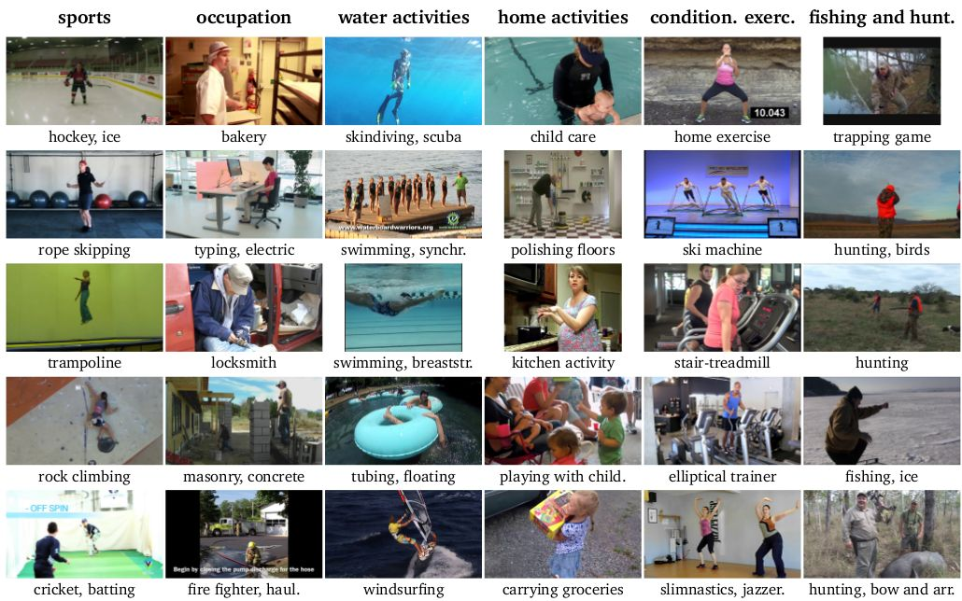
2D Pose Benchmark: MPII dataset
Andriluka et al., 2d human pose estimation: New benchmark and state of the art analysis, CVPR 2014
YouTube videos, 410 daily activities
Complex poses and appearances
25k images, 40k annotated 2D poses
Notes:
Let’s take a look at the state-of-the-art results on the 2D human pose benchmark MPII dataset

Slide 6
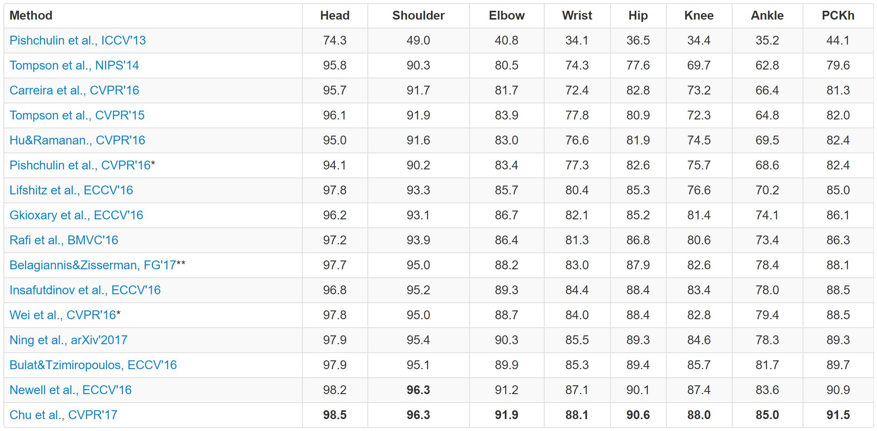
MPII Leader Board
Metric: percentage of correct keypoints (PCK). The higher, the better.
Only one regression method
Not competitive to detection
Notes:
This is the leaderboard of MPII.
And there is only one method that is regression based and the result is not competitive to the other detection based methods.

Slide 7
Reason: exploit joint dependency
Detection
Regression
Per-pixel classification
Output: likelihood score maps
Used in most 2D methods
State-of-the-art result
Scoremap is more expressive
Location regression
Output: key points location
Only used in a few 2D methods
Unsatisfactory result
Dependency not well exploited
Notes:
This is because the scoremaps are more expressive then the direct joint and the dependency of joints are better exploited.

Slide 8
Reason: exploit joint dependency
Detection
Regression
Per-pixel classification
Output: likelihood score maps
Used in most 2D methods
State-of-the-art result
Multi-stage, error feedback
Location regression
Output: key points location
Only used in a few 2D methods
Unsatisfactory result
Dependency not well exploited
Notes:
The reason is that those detection based methods better exploit the joint dependency in human pose. All of them share a most important high level idea: They all adopt a multi-stage error feedback architecture, where the output of the previous stage is used as input to enhance the learning of the next stage. This idea is naturally combined with the detection method and acts poorly on regression method.
So first, let’s have a brief review of this important idea.

Slide 9
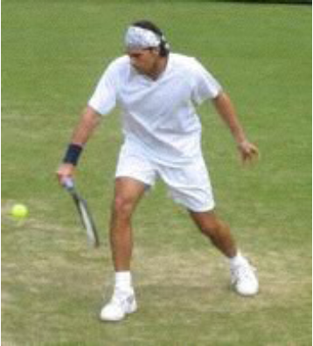
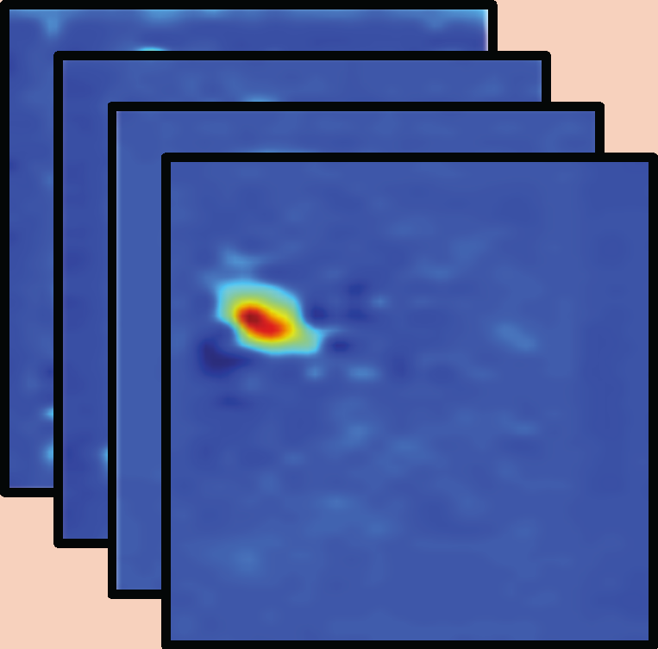
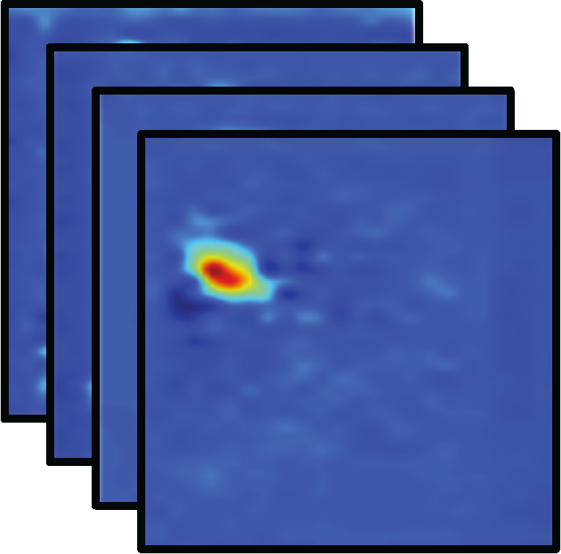
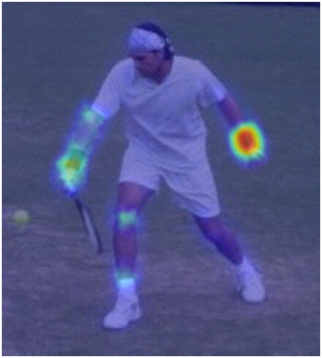
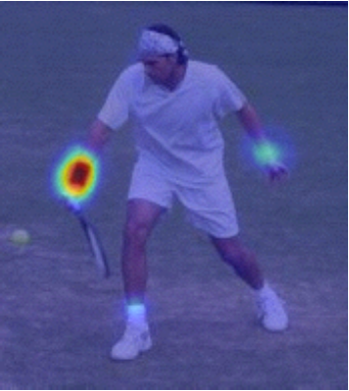
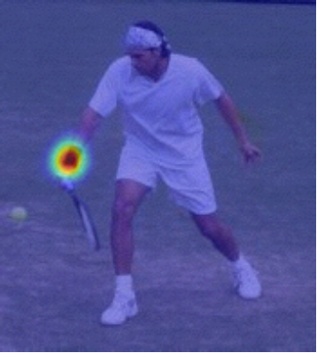
Multi-stage Error Feedback (Detection)
Stage1
Stage2
StageT
CNN
CNN
……
CNN
……
Right Wrist
Right Wrist
Right Wrist
Notes:
At the first stage, given an input image the CNN network outputs the joint score maps. At stage2, the original image is combined with the output score maps from stage1 and input into another CNN network and also output the joint score maps. This block is repeated several times to get a multi-stage architecture and trained end-to-end. The quality of those score maps are getting better and better with stages.
This is an example. The score map for the right wrist joint is ambiguous and weak and at early stages and gradually gets clean and strong with more stages.

Slide 10
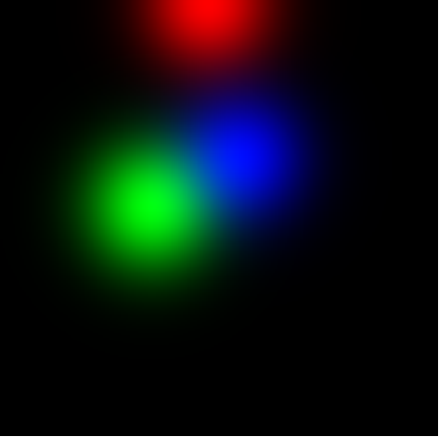
Multi-stage Error Feedback (Regression)
Stage1
Stage2
StageT
CNN
CNN
……
CNN
Gaussian heatmap render
Gaussian heatmap render
Not as good as detection.
Rendered Gaussian maps not expressive
Joint dependency not fully exploit.
Notes:
The regression method can also adopt the Multi-stage Error Feedback idea. We only need to generate the score maps using gaussian rendering centered on the estimated key point locations.
It also improves the regression result but not as good as detection methods. Because the rendered Gaussian map is not as expressive as the detected score maps and the joint dependency can’t be fully exploited.

Slide 11
Generalization
Detection
Regression
Per-pixel classification
Output: likelihood score maps
Used in most 2D methods
State-of-the-art result
Scoremap is more expressive
Hard to generalize to 3D task
Location regression
Output: key points location
Only used in a few 2D methods
Unsatisfactory result
Dependency not well exploited
General for both 2D and 3D task
Notes:
However the score maps are hard to generalize to 3D task, because the 3D score maps are too demanding for memory and computation. On the contrary, regression is more straightforward and general for both 2D and 3D tasks.

Slide 12
Motivation of this work
Detection
Regression
Per-pixel classification
Output: likelihood score maps
Used in most 2D methods
State-of-the-art result
Scoremaps are more expressive
Hard to generalize to 3D task
Location regression
Output: key points location
Only used in a few 2D methods
Unsatisfactory result
Dependency not well exploited
General for both 2D and 3D task
Notes:
Our motivation is to investigate how to make regression based methods better exploit the joint dependency. Since it is general for both 2D and 3D tasks.

Slide 13
Proposed: structure-aware regression method
A novel pose representation and novel loss function
Better exploit joint dependency
Unified framework for 3D and 2D tasks
Complementary to network architectures
State-of-the-art on both 2D and 3D tasks (ICCV2017 submission)

Slide 14
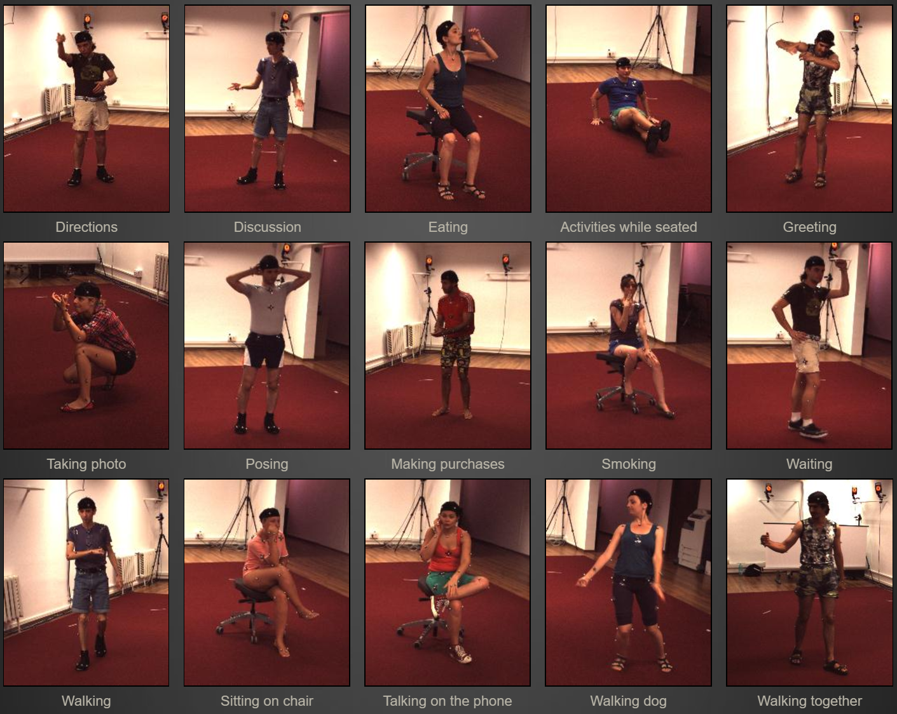
3D Pose Benchmark: Human 3.6M dataset
Lonescu et al., Human3.6m: Large scale datasets and predictive methods for 3d human sensing in natural environments, PAMI 2014
Ground truth by motion capture
7 subjects x 15 actions x 4 cameras
Millions of RGB frames
Notes:
First let’s take a look at the overall performance of our method on the 3D and 2D human pose benchmarks.

Slide 15
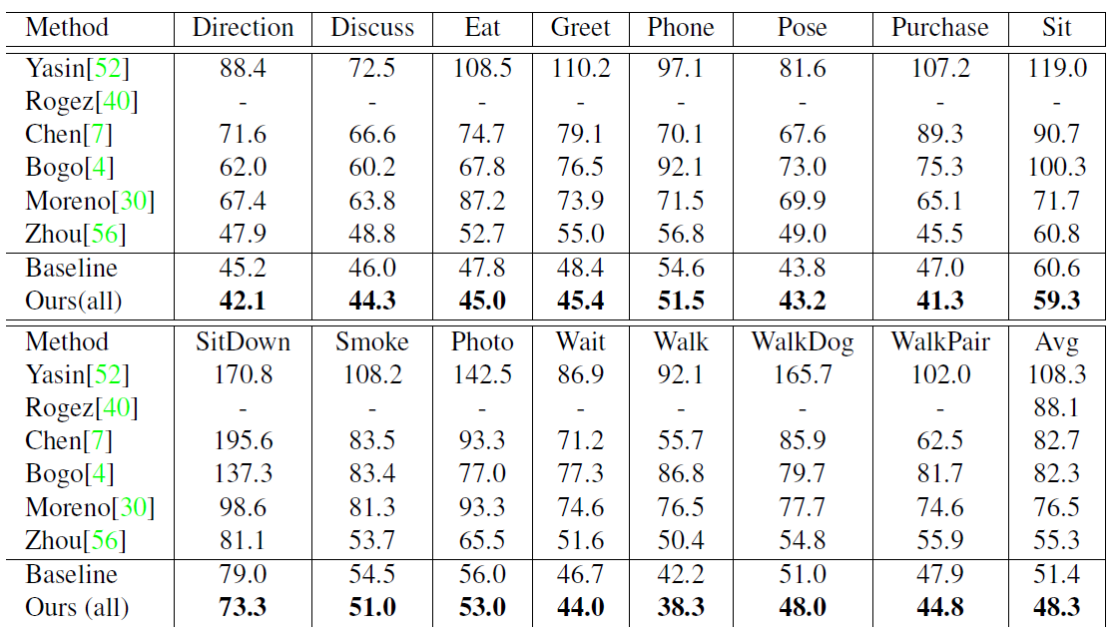
Our Performance (3D)
Dataset: Human3.6M.
Metrics: mean joint position error in mm. The lower, the better.
Advance the state-of-the-art a large margin, 12.7%.
A record of 48.3mm average joint error.
Notes:
In general, we have achieved the beset 3D human pose estimation performance.

Slide 16
Our Performance (2D)
Dataset: MPII.
Metrics: percentage of correct keypoints (PCK). The higher, the better.
Advance the state-of-the-art regression method 6.3%.
Competitive with the state-of-the-art detection methods.
Notes:
For the 2D human pose estimation problem, we are the best regression based method and

Slide 17
Two Key Techniques
Bone based pose representation
Simplify the problem
Compositional loss function
Encodes long range interactions between bones
Notes:
Our method consists of two key techniques.
The first is a new bone based pose representation that simplify this problem.
And the second is a compositional loss function that encodes long range interactions between bones.

Slide 18
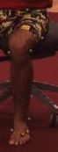
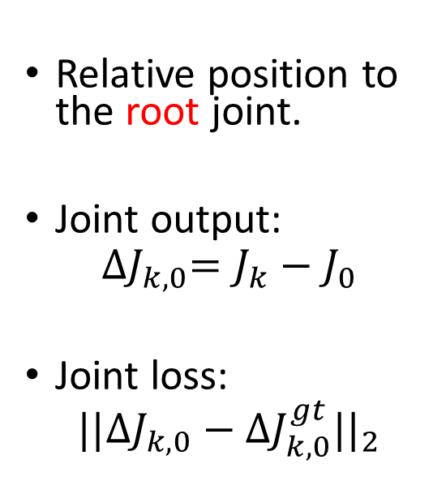
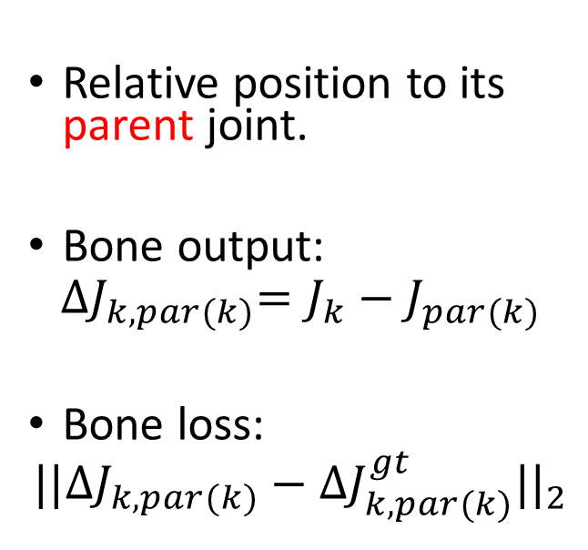
Pose Representation: Joint VS. Bone
Joint
Bone
Relative position to the root joint.
Joint output:
$${∆J}_{k,0}=J_{k}−J_{0}$$
Joint loss:
$${||{∆J}_{k,0}−{∆J}_{k,0}^{gt}||}_{2}$$
Relative position to its parent joint.
Bone output:
$${∆J}_{k,par(k)}=J_{k}−J_{par(k)}$$
Bone loss:
$${||{∆J}_{k,par(k)}−{∆J}_{k,par(k)}^{gt}||}_{2}$$
J0
J0
J1
J1
J2
J2
Notes:
First is a novel pose representation using bones.
Most previous regression works represent pose with the joint locations. Usually, a root joint is selected as origin. And the pose is defined as a relative position from one joint to this root joint.
The network will directly output joint positions and supervised by the joint position loss.
Instead, for the bone representation, a posed is defined as the relative position from one joint to its parent joint along the kinematic tree.
The network will output bone positions and is supervised by the bone position loss

Slide 19
Joint Representation: Drawbacks
Joints independently estimated
Internal structure not exploited
Geometric constraint not satisfied
Bone length not constant
Joint angle may out of range
Notes:
There are several drawbacks of the native joint representation.
First, joints are estimated independently.
the internal structure is not explicitly exploited.
And the Geometric constraint among these joints are not satisfied.
For example, the bone length is not constant and the joint angle may get out of range.

Slide 20
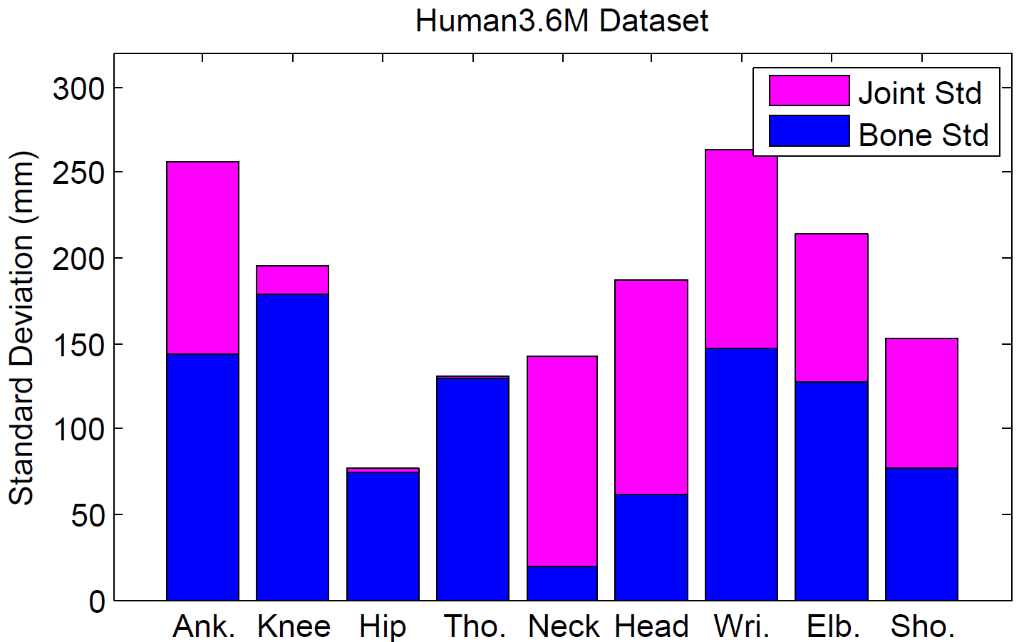
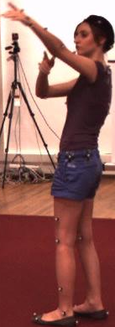
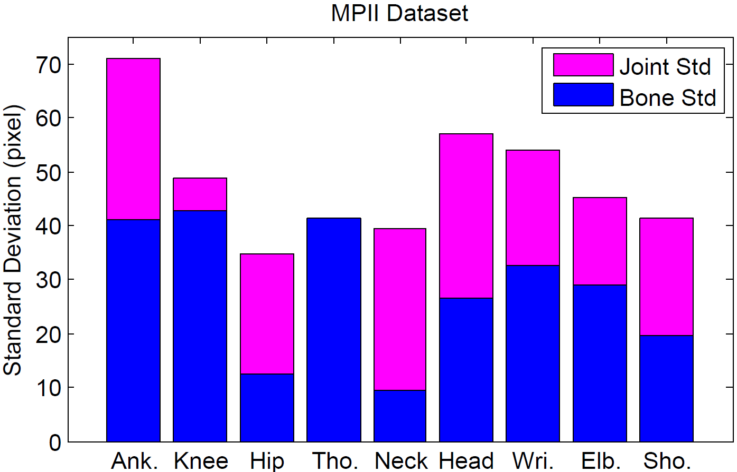
Bone Representation: Advantages
Joints are connected in a tree structure
Bones are primitive units and local
Significantly smaller variance in targets
Application convenience: local motion is enough
Geometric constraint better satisfied
(New evaluation metrics)
Name | Type | Definition
Joint Error | Absolute location | Mean per joint position error.
Bone Error | Relative location | Mean per bone position error.
Bone Std | Physical validity | Bone length standard deviation.
Illegal Angle | Physical validity | Percentage of illegal joint angle.
Gesture: Pointing
Direction of forearm
Standard deviation of bones and joints for the 3D Human3.6M dataset and 2D MPII dataset
Notes:
On the contrary, there are many advantages for the bone representation:
In which joints are connected with each other in a tree structure and bones are the primitive units in this structure and a local representation.
First of all, the variance in bones are significantly smaller then joints. This is the standard deviation of bones and joints for the 3D Human3.6M dataset and 2D MPII dataset. Blue represents bones and pink represent joints, bones have much smaller variance.
Second, Many pose-driven applications only need local motion in bones instead of the global joint locations. For example, the pointing command depends on the direction of the forearm. The difference between stand and squat gesture depends on the bending angle between thigh and shin.
Last but not least, the geometric constraint like constant bone length and valid joint angle can be better satisfied. In order to prove this, we introduce three new evaluate metrics besides the absolute joint location error.
The first one is the local bone position error.
The second is the bone length standard deviation of the same person in the sequential video frames.
The last one is the percentage of illegal joint angle.

Slide 21
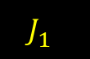
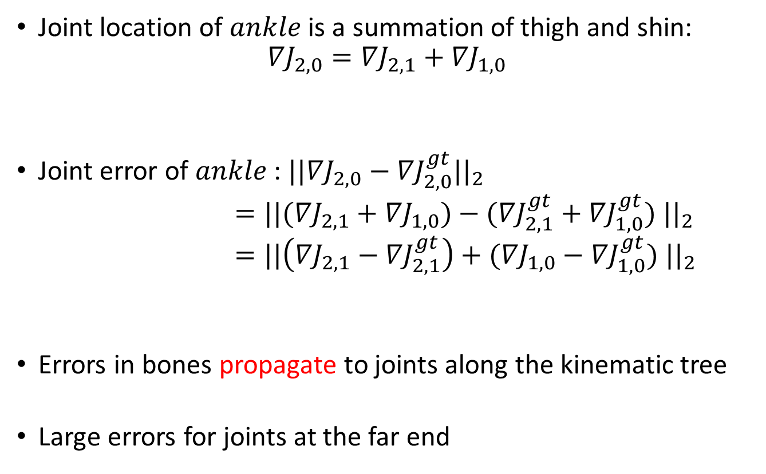
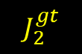
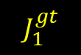
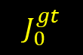
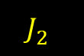
Use Bone Loss Only: Drawback
$$J_{0}^{gt}$$
Joint location of $ankle$ is a summation of thigh and shin:
$${∇J}_{2,0}={∇J}_{2,1}+{∇J}_{1,0}$$
Joint error of $ankle$: ${||{∇J}_{2,0}−{∇J}_{2,0}^{gt}||}_{2}$
$={||({∇J}_{2,1}+{∇J}_{1,0})−({∇J}_{2,1}^{gt}+{∇J}_{1,0}^{gt}) ||}_{2}$
$={||\left({∇J}_{2,1}−{∇J}_{2,1}^{gt}\right)+({∇J}_{1,0}−{∇J}_{1,0}^{gt}) ||}_{2}$
Errors in bones propagate to joints along the kinematic tree
Large errors for joints at the far end
Hip
bone 2
bone 1
$$J_{1}^{gt}$$
Knee
$$J_{1}^{}$$
$$J_{2}^{gt}$$
Ankle
Error in shin
Error in thigh
$$J_{2}^{}$$
Ground truth joint
Ground truth bone
Estimated bone
Notes:
Given so many advantages of bone representation. There is one drawback of using bone loss only.
For example, This is the ground truth of a simple pose with three joints hip, knee, ankle and two bones thigh and shin. Then, the network will predict two bones in orange.
But if we consider about the joint error of ankle. It is effected by both of the estimated thigh and shin. Since the joint location of ankle is a summation of the thigh and shin.
In other words, errors in bones propagate to joints along the kinematic tree.
This will cause large errors for joints at the far end.

Slide 22
Motivation
Besides local bone loss only
Long-range losses should also be considered and balanced over the intermediate bones.

Slide 23
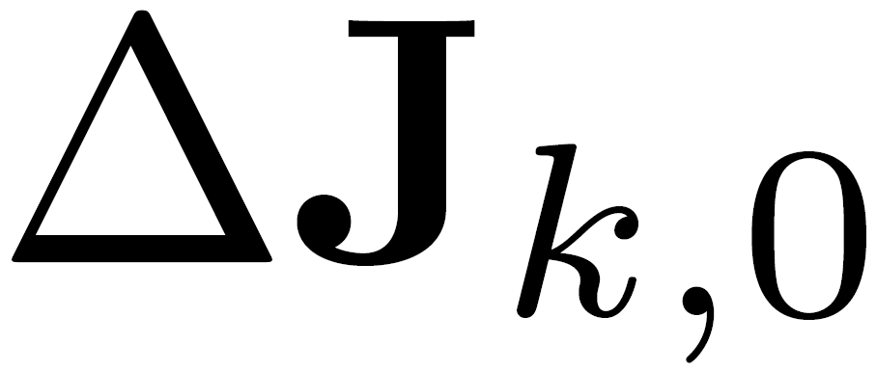
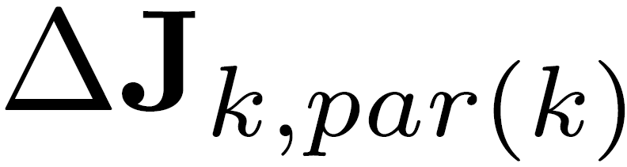
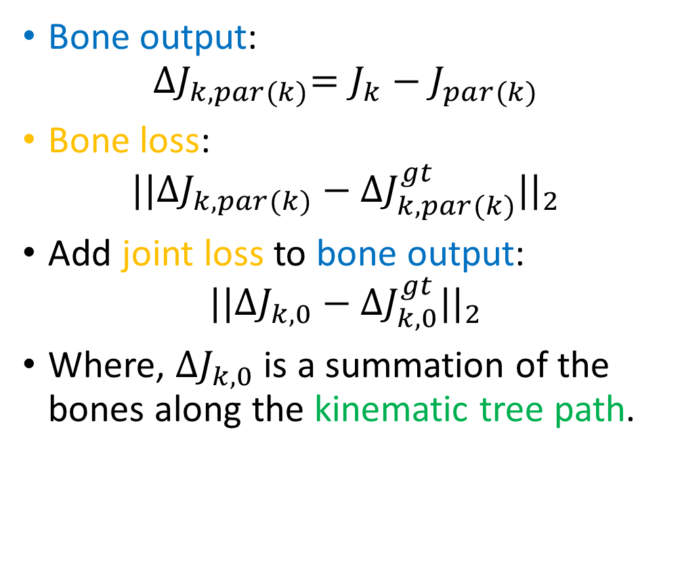
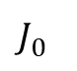
Add Joint Loss to Bone Outputs
Bone output:
$${∆J}_{k,par(k)}=J_{k}−J_{par(k)}$$
Bone loss:
$${||{∆J}_{k,par(k)}−{∆J}_{k,par(k)}^{gt}||}_{2}$$
Add joint loss to bone output:
$${||{∆J}_{k,0}−{∆J}_{k,0}^{gt}||}_{2}$$
Where, ${∆J}_{k,0}$ is a summation of the bones along the kinematic tree path.
$$J_{0}^{}$$
Notes:
So, it is quite intuitive for us to add joint loss to the bone outputs
Given the output bones,
The native bone loss is added to the individual bones.
And we can also add joint loss to the output bones
Because a joint position is a summation of the bones along the kinematic tree path.

Slide 24
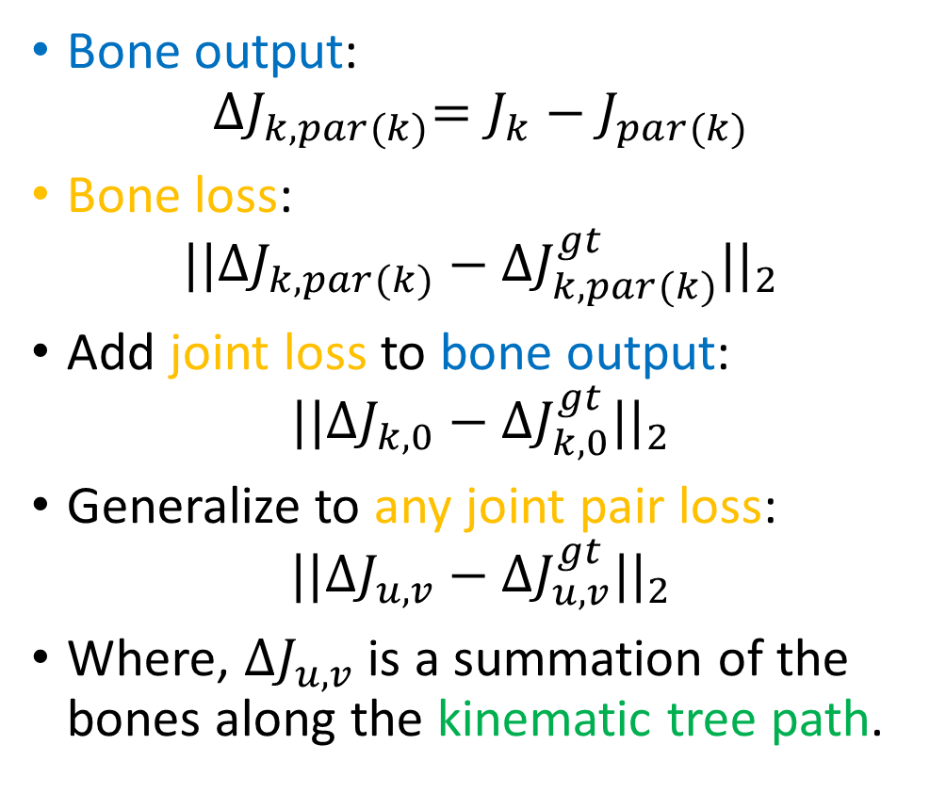
Generalize to Any Joint Pair Loss
Bone output:
$${∆J}_{k,par(k)}=J_{k}−J_{par(k)}$$
Bone loss:
$${||{∆J}_{k,par(k)}−{∆J}_{k,par(k)}^{gt}||}_{2}$$
Add joint loss to bone output:
$${||{∆J}_{k,0}−{∆J}_{k,0}^{gt}||}_{2}$$
Generalize to any joint pair loss:
$${||{∆J}_{u,v}−{∆J}_{u,v}^{gt}||}_{2}$$
Where, ${∆J}_{u,v}$ is a summation of the bones along the kinematic tree path.
Notes:
Moreover, the joint location loss can be generalized to any joint pair loss. The position the joint pair is also a summation of the bones along the kinematic tree path.

Slide 25
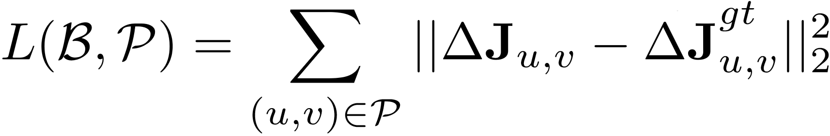
Compositional Loss Function
Regression output: bones
Ground truth relative position
Joint pair set
Relative position of a joint pair, a summation of the bones along the kinematic tree.
The long-range joint pair losses are considered and balanced over the intermediate bones!
The ground truth is sufficiently exploited!
Notes:
Finally, this is the formal definition of our compositional function. Given the bone outputs, and a joint pair set. The relative position of those joint pairs are supervised by the ground truth.
Note that the joint pair position is composed by the bones.
In this way, the long-range joint pair losses are considered and balanced over the intermediate bones.

Slide 26
Comparison Experiments
Network: 50-layer ResNet
Dataset:
3D benchmark: Human3.6M
2D benchmark: MPII
Methods:
Notation
Outputs
Loss
State
-
of
-
the
-
art
-
-
Our Baseline
Joints
Joint position
loss
Ours (bone)
Bones
Bone position
loss
Ours (all)
Bones
All joint pair position
loss
Notes:
Let’s do some comparison experiments to justify the efficiency of our techniques.
All of our experiments use the 50-layer resnet architecture.
Evaluated on the standard 2D and 3D benchmark are used
We compare our result with the state of the art.
We also implement a baseline using joint representation and joint position loss.
We compare the bone representation and bone loss only with the baseline to justify the efficiency of bone representation.
Then we add compositional loss function to it justify its efficiency.

Slide 27
3D Human Pose Results
A strong baseline, already state-of-the-art.
Bone representation is superior to joint.
Compositional loss function is effective.
[1] Zhou et al., Deep kinematic pose regression, ECCV 2016.
Metric
State of the art
Baseline
Ours (bone)
Ours (all)
Joint Error (mm)
78.7 [1]
75.0
75.0
(0.0%)
67.5
(
10.0%
)
The lower, the better
Bone Error (mm)
-
65.5
62.3
58.4
(4.9%)
(
10.8%
)
Bone
Std
(mm)
-
26.4
21.9
(17.0%)
21.7
(
17.8%
)
Illegal Angle (%)
-
3.7%
3.3%
(10.8%)
2.5%
(
32.4%
)

Slide 28
Apply to 2D Task (Regression Based)
Stage
Metric
State of the art
Baseline
Ours(all)
Joint Error (mm)
-
29.7
27.2 (
8.4%
)
1
Bone Error (mm)
-
24.8
22.5 (
9.3%
)
Two stage error feedback
PCK (%)
-
76.5%
79.6% (
4.1%
)
Joint Error (mm)
-
25.0
22.8 (
8.8%
)
2
Bone Error (mm)
-
21.2
19.5 (
8.0%
)
PCK (%)
81.3% [2]
82.9%
86.4% (
4
.2%
)
Complementary to “multi-stage error feedback”:
A two-stage error feedback baseline.
Stage1: direct joint regression.
Stage2: use joint prediction from stage1.
Our method improves both stages.
[2] Carreira et al., Human pose estimation with iterative error feedback, CVPR 2016.
Notes:
For the 2D human pose estimation, we also want to show that our method is complementary to other important techniques like the multi-stage error feedback.
We implement a two stage error feedback baseline, the first stage is the direct joint location regression, the second stage use the joint prediction from stage1
It is already better than the best regression based method.
Our method improves both stages. And it is now much competitive to the regression based methods.

Slide 29
Unified 2D and 3D Pose Regression
Our method general for 3D and 2D task.
Easily mixed 3D and 2D data training:
Decompose the loss into xy part and z part.
xy part is always valid for both 3D and 2D samples.
z part is only computed for 3D samples and set to 0 for 2D samples.
Significantly improve 3D pose performance
Joint Error 67.5->48.3, 28.4%.
Plausible and convincing 3D pose on in-the-wild image.
Notes:
There is another by-product of our method.
Since our method is general for both 3D and 2D tasks. We can easily mix the 3D and 2D training. It is technically very simple.
We only need to decompose the loss into xy and z part….
This mixed training bring significant improvements to 3D pose performance. Because it makes use of both
Better image generalization from 2D data.
High 3D pose precision and variation from 3D data.
Another benefit is that it produces plausible and convincing 3D pose result on in-the-wild image.

Slide 30
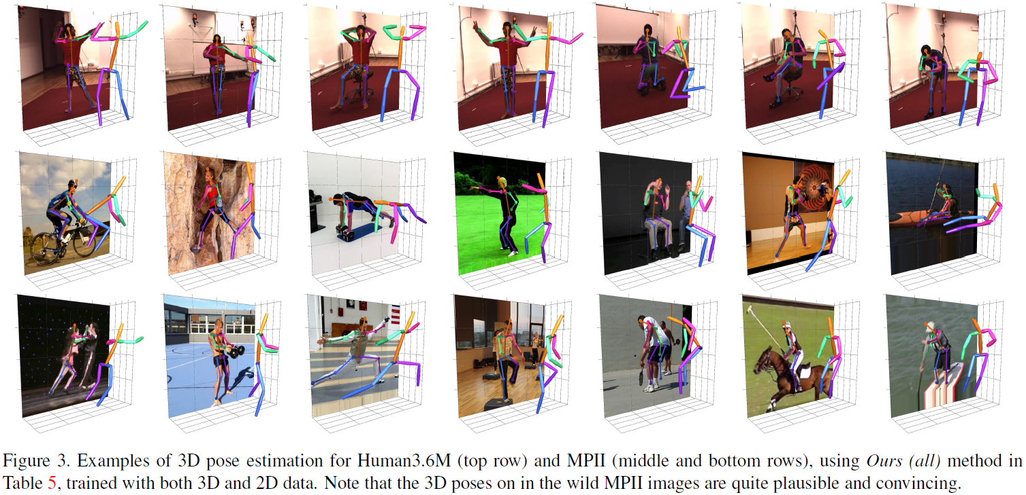
Qualitative Result

Slide 31
Video Result

Slide 32
Future Work
More sophisticate geometric structure representation.
Ambiguity and multiple hypothesis.
Video consistency and smoothness.
Unified framework for human detection, 3D human pose, attribute and action.

Slide 33
Thanks!

